Slide 1

SIGN LANGUAGE RECOGNITION USING MACHINE LEARNING

Slide 2
Presented by :- Saquib A Khazi – 01FM19MCA006 Priyanka Rokhade - 01FM19MCA014 Under the guidance of :- Prof Shivananda Seeri Prof Ashok Chikaraddi
✋👆
👉👍

Slide 3
Table of Contents
Introduction
Objective
Problem statement
Block diagram
Requirements
Conclusion

Slide 4
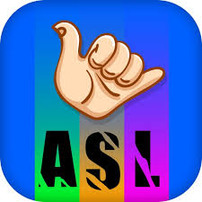


Introduction
The goal of this project was to build a neural network able to classify which letter of the American Sign Language (ASL) alphabet is being signed, given an image of a signing hand.
This project is a first step towards building a possible sign language translator, which can take communications in sign language and translate them into written and oral language.
Such a translator would greatly lower the barrier for many deaf and mute individuals to be able to better communicate with others in day-to-day interactions.

Slide 5
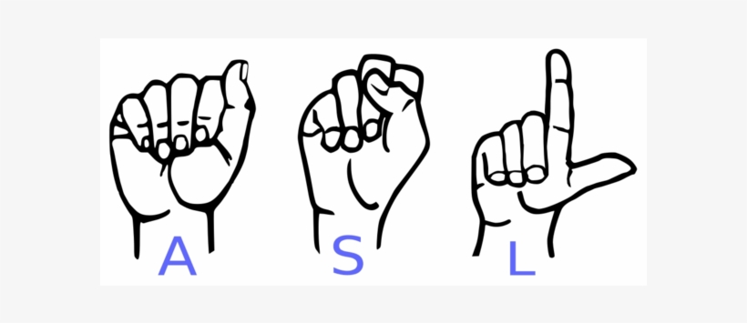
Objective
Communication is always having a great impact in every domain and how it is considered the meaning of the thoughts and expressions that attract the researchers to bridge this gap for every living being.
The objective of this project is to identify the symbolic expression through images so that the communication gap between a normal and hearing-impaired person can be easily bridged.

Slide 6

Problem Statement
To design and develop an ML project for deaf and dumb people for communicating with the normal people.
Given a hand gesture, implementing such an application which detects pre-defined American sign language (ASL) in a real time through hand gestures, customized gesture so that the problems faced by persons who aren’t able to talk vocally can be accommodated with technological assistance and the barrier of expressing can be overshadowed.

Slide 7
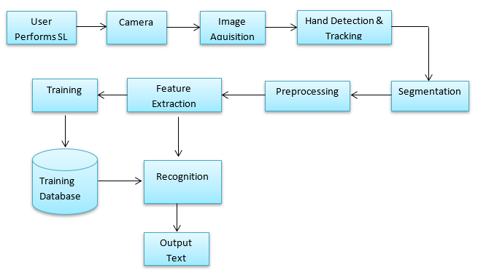
Block Diagram

Slide 8
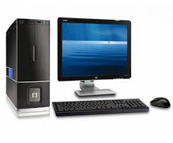

Requirements
Hardware
HDD: 2 GB available disk space.
GPU: NVIDIA GTX 1060 or higher or any AMD equivalent card.
Camera: At least 5MP.
Software
Operating System: Windows 10.
Programming: Python, OpenCV, TensorFlow, NumPy, Matplotlib, Keras.

Slide 9

Conclusion
In this project, we built a system which will correctly recognize ASL Alphabets and Numbers, which mainly depend on hand and fingers. The model used in this project uses CNN for detection of 26 English ASL alphabets using different image enhancement techniques.
This model also uses Convolution layer to highlight the dominant features and max pooling layers to reduce computing cost.
Our project gives 100% accuracy of sign detection.

Slide 10
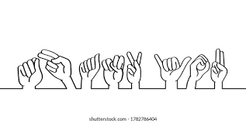
THANK YOU!

